Slide 1
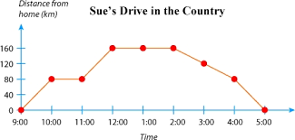
Bell Work
What are some things you notice about the graph

Slide 2
ALGEBRA 3
Day 5

Slide 3
Objective
Algebra 1-2 Review
Continue to Use Graphing Calculator
Intro to Algebra 3

Slide 4


Algebra 1-2 Review. Evaluate:
${−4+7(5}^{2}−2∗10)−8=$
$$24÷6∗2=$$ ${3−10+9}^{2}+\sqrt{36}=$
$$\frac{1}{2}−6\left(\frac{3}{5}+\frac{1}{4}\right)=$$

Slide 5

Algebra 1-2 Review. Solve for the Indicated Variable:
30$=6x−12 solve for x$
$$24−3w+2=47 solve for w$$
$$8t+10r=20m solve for t$$

Slide 6
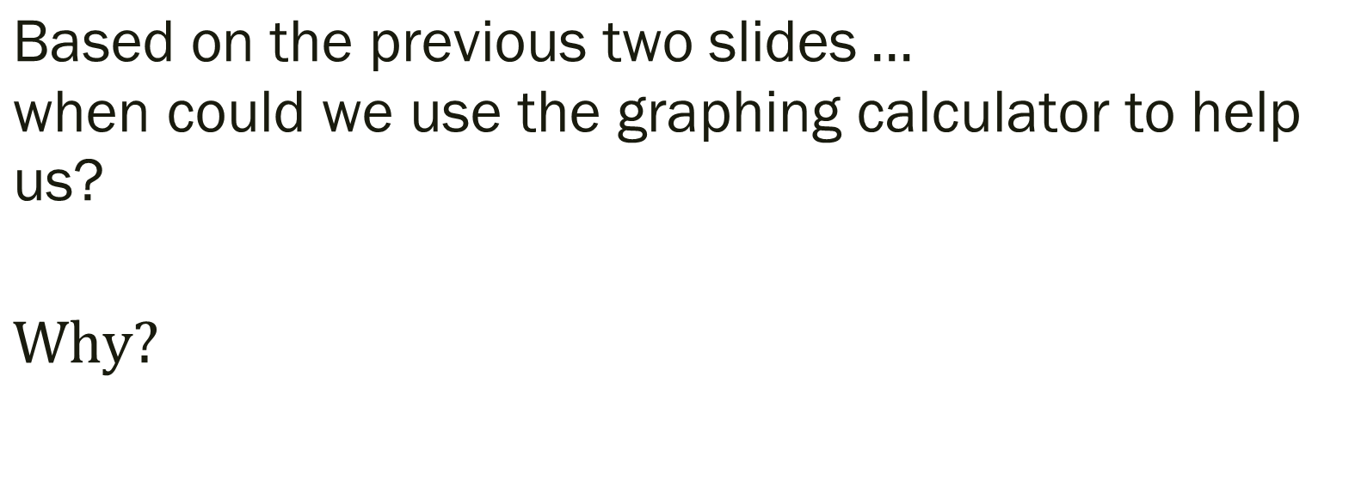
$$\text{B}\text{ased} \text{on} \text{the} \text{previous} \text{two} \text{slides}…$$
$$\text{w}\text{h}\text{en} \text{could} \text{we} \text{use} \text{the} \text{graphing} \text{calculator} \text{to} \text{help} \text{us}\text{?}$$
$$Why?$$

Slide 7

Graphing Calculator: Where are the buttons we need?!
$y=−4x+6$
$y=5x^{2}−3$
What happens when we add an exponent to the variable?

Slide 8
Exit Ticket
Make previous the graph look like it is the path a ball would take when thrown.
What do you notice as you change the numbers? What happens if we do the same thing with the first equation?

